Slide 1

ISCG6420 JavaScript
Semester 1, 2017
Notes:
Use title slide layout

Slide 2
Object oriented programming
The basic idea of OOP is that we use objects to model real world things that we want to represent inside our programs, and/or provide a simple way to access functionality that would otherwise be hard or impossible to make use of.

Slide 3
Defining and object template
Consider a simple program that displays information about the students and lecturers at Unitec.
We may know a lot of information about a particular person, but should start with providing some very generic information, such as name, age, gender.
This is known as abstraction – creating a simple model of a more complex thing that represents its most important aspects in a way that is easy to work.

Slide 4
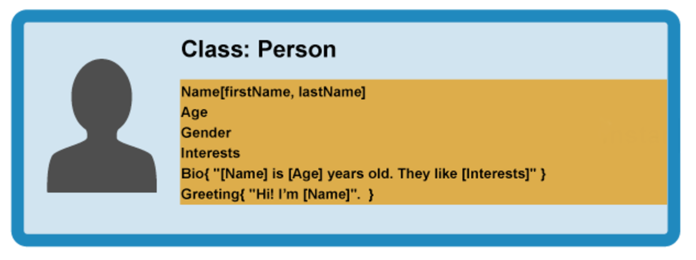

Slide 5
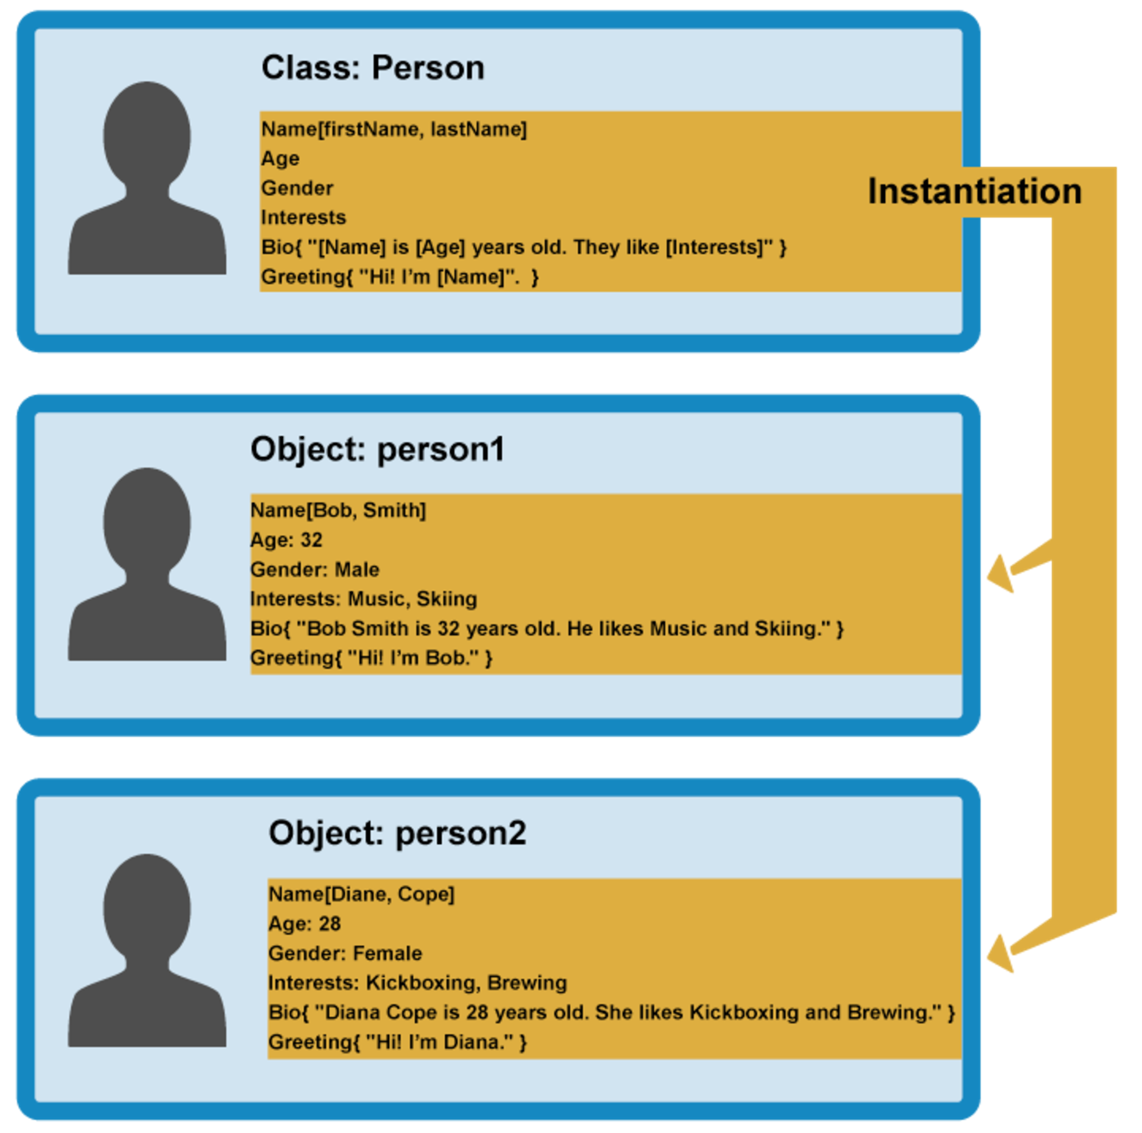
Creating actual objects

Slide 6
Creating actual objects
When an object instance is created from a class, then class’s constructor function is run to create it. This process of creating an object instance from a class is called instantiation – the object instance is instantiated from the class.

Slide 7
Specialist classes
In OOP we can create classes based on other classes – these new child classes can be made to inherit the data and code features of their parent class, so you can avoid duplicating some functionality which is common to all the objects.

Slide 8
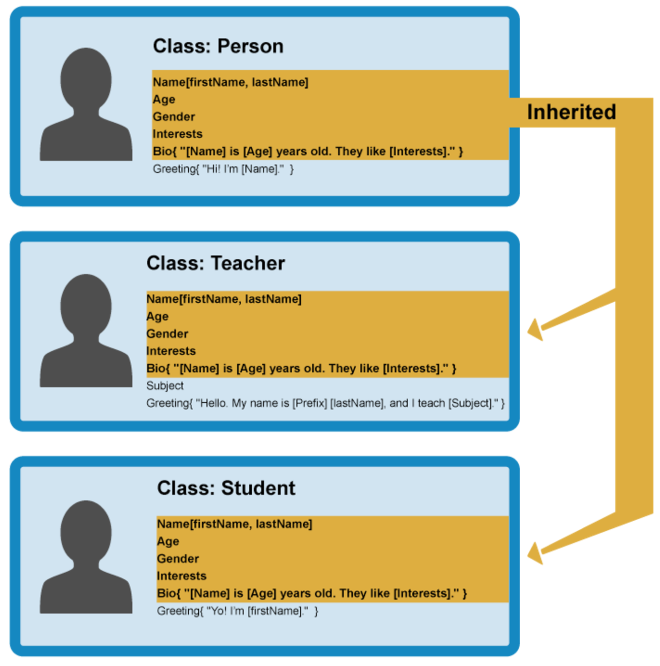

Slide 9
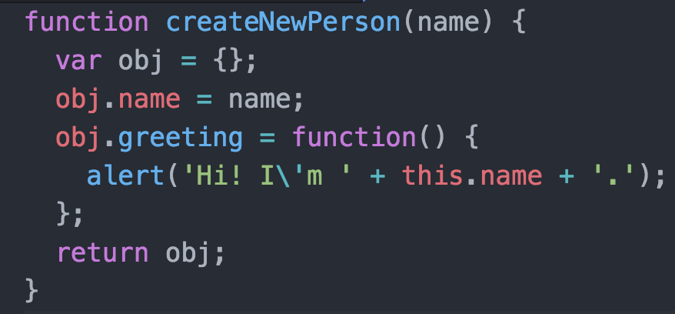
Constructor and object instances
JavaScript uses special functions called constructor functions (instead of classes) to define objects and their features.

Slide 10
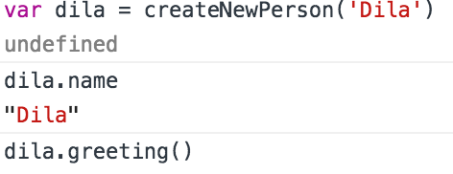
In your console:
This worked well, however, we first needed to create an empty object first. Instead, we should use constructors

Slide 11
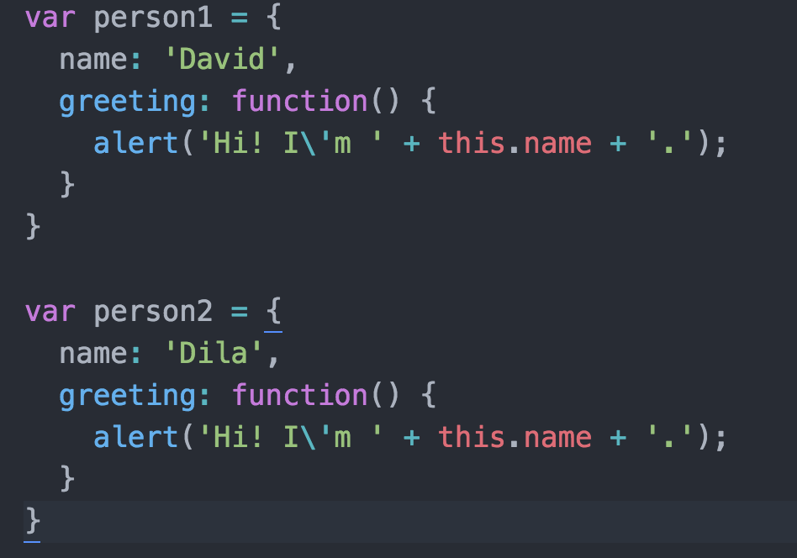
What is ‘this’?
This refers to the current object the code is being written inside – so in the case outlined on the previous slide this is equivalent to person. Why bother? Useful when we have, say, two different person objects and want to ensure we refer to the correct ones.

Slide 12
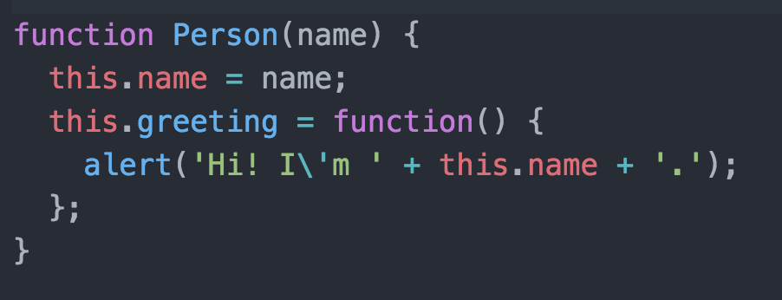
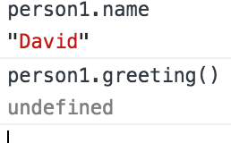
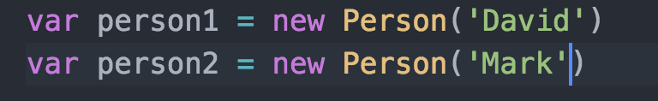
Constructors
And now in order for a constructor to create some objects, add the following to your code above:

Slide 13
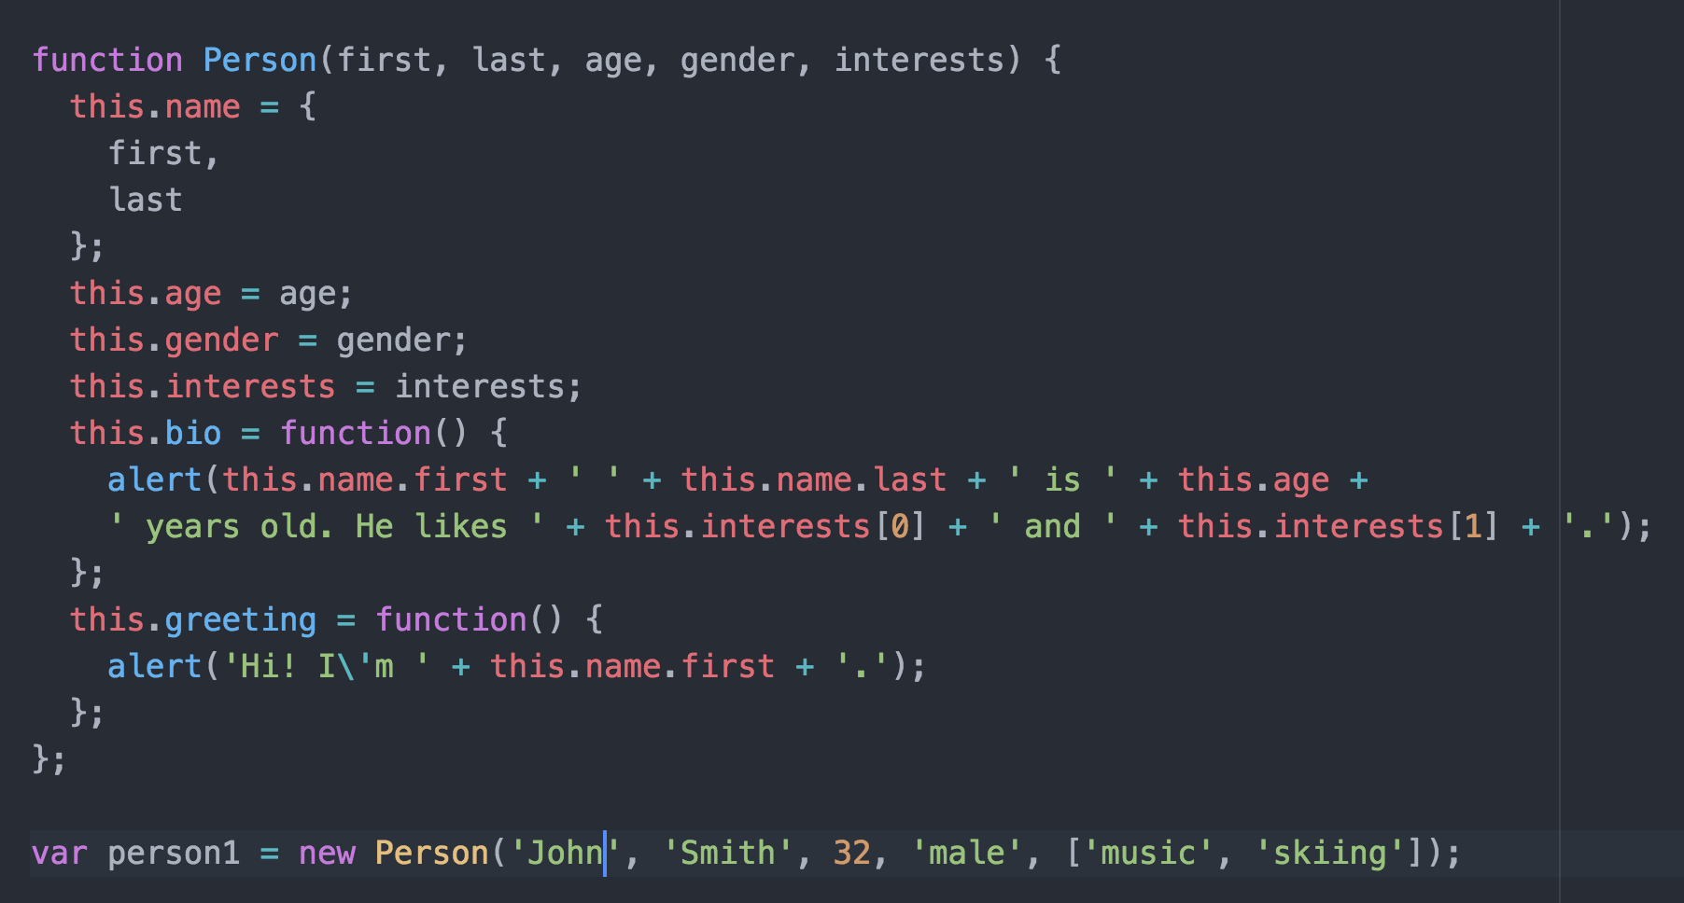

Slide 14
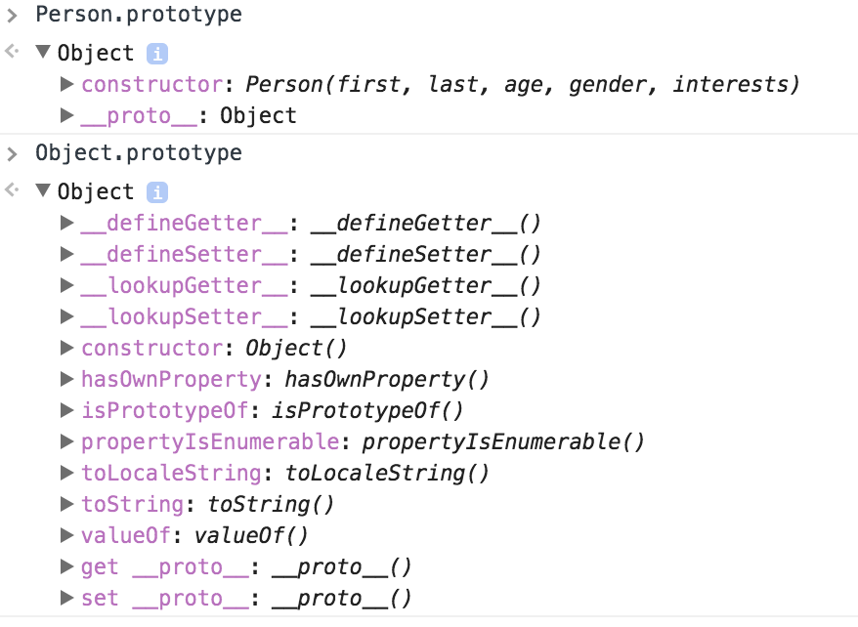

Slide 15

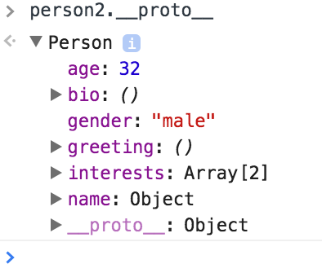
Create()
Create() actually does is to create a new object from a specified prototype object. Here’ person2 is being created using person1 as a prototype object.
You can check this by typing the following:

Slide 16
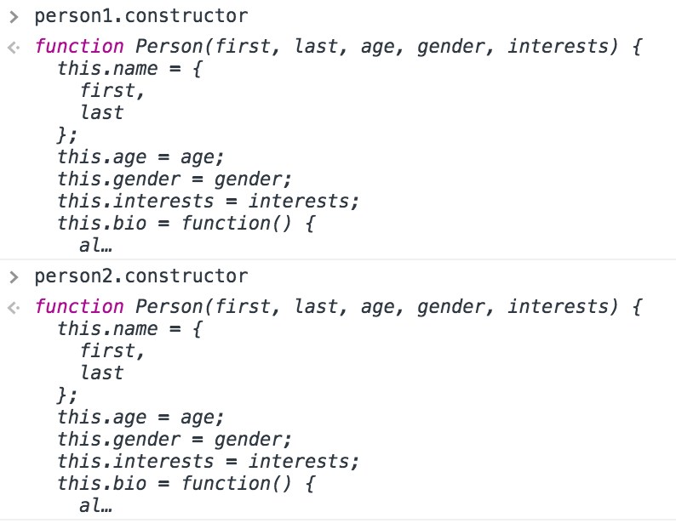
The constructor property
Every function has a prototype property whose value is an object containing a constructor property. This constructor property points to the original constructor function.

Slide 17
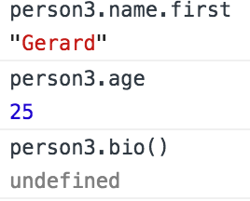
Now you can create another object instance from that constructor by doing the following:
Now try accessing your new object’s features:

